Slide 1




SCHOLARSHIP PORTAL
Presented by
NAME:A.RODDICK BEVAN, G.ROSARIO
REGNO:2222128031, 2222128032
CLASS:III Bsc Computer Science

Slide 2
contents
Abstract
Software & Hardware used
Module Description
Data Flow diagram
Database Design
Input Design
Output\ Reports
Conclusion
Future Enhancement

Slide 3
ABSTRACT
This project proposes the development of a web-based Scholarship Portal aimed at streamlining the scholarship application and disbursement process.
The portal will showcase various types of scholarships available, allowing students to search and filter scholarships based on their eligibility criteria.
Additionally, the portal will send notifications to students who are eligible for specific scholarships, ensuring they stay informed and up-to-date about available opportunities.
The portal will provide features such as student registration, scholarship listing, online application, administrator dashboard, and etc
Notes:
3

Slide 4
SOFTWARE & HARDWARE
SOFTWARE SPECIFICATION
Operating system : Windows 11 ,10, 8
Front End : Python
Back End : MySQL SERVER
IDLE : Python 2.7 IDLE
HARDWARE SPECIFICATION
Processor : Intel i5
RAM : 16 GB
ROM : 512 GB SSD
Keyboard : 104 keys
Mouse : 3 buttons

Slide 5
MODULE DESCRIPTION
Admin
Login
View Scholarship Request
Accept /Reject Scholarship Request
Sanction Amount
Student
Register
Login
Apply Scholarship
Notification
View Status

Slide 6
ADMIN MODULE
Login
In this module, the admin can login in the system using his/her username and password.
View Scholarship Request
In this module, the admin can view the student scholarship request.
Accept /Reject Scholarship Request
In this module, the admin can accept/ reject the student scholarship request.
Sanction Amount
In this module used to make a amount sanction. This module contains user’s card details like name, card no, amount etc.

Slide 7
STUDENT MODULE
Login
In this module, the student can login in the system using username and password.
Apply Scholarship
In this module, the student can apply the scholarship.
Notification
If the admin can update the status of accept/ reject request and amount sanction, the student can get the automatic notification.
View Status
After received notification the student can check the status of accept/ reject request and amount sanction in this module.

Slide 8



DATA FLOW DIAGRAM
ONLINE SCHOLARSHIP MANAGEMENT SYSTEM
Admin
Student
login
Register
View Scholarship Request
Login
Apply Scholarship
Accept /Reject Scholarship Request
View Status

Slide 9
DATABASE DESIGN
SCHOLARSHIP APPLY
Field | Type | Null | Default
id | bigint(20) | Yes | NULL
UserName | varchar(250) | Yes | NULL
Mobile | varchar(250) | Yes | NULL
schloarship | varchar(250) | Yes | NULL
Certificate1 | varchar(500) | Yes | NULL
Certificate2 | varchar(500) | Yes | NULL
Percentage | varchar(250) | Yes | NULL
Status | varchar(250) | Yes | NULL

Slide 10
SCHOLARSHIP
Field | Type | Null | Default
id | bigint(10) | Yes | NULL
ScholarshipName | varchar(250) | Yes | NULL
ScholarshipType | varchar(250) | Yes | NULL
Announced | varchar(250) | Yes | NULL
Year | varchar(250) | Yes | NULL
Certificate1 | varchar(250) | Yes | NULL
Certificate2 | varchar(250) | Yes | NULL
OtherInfo | varchar(500) | Yes | NULL

Slide 11
STUDENT
Field | Type | Null | Default
id | bigint(20) | Yes | NULL
RegisterNo | varchar(250) | Yes | NULL
Name | varchar(250) | Yes | NULL
Gender | varchar(250) | Yes | NULL
Mobile | varchar(250) | Yes | NULL
Email | varchar(250) | Yes | NULL
Address | varchar(500) | Yes | NULL
Department | varchar(250) | Yes | NULL
Batch | varchar(250) | Yes | NULL
Year | varchar(250) | Yes | NULL
Shift | varchar(250) | Yes | NULL

Slide 12
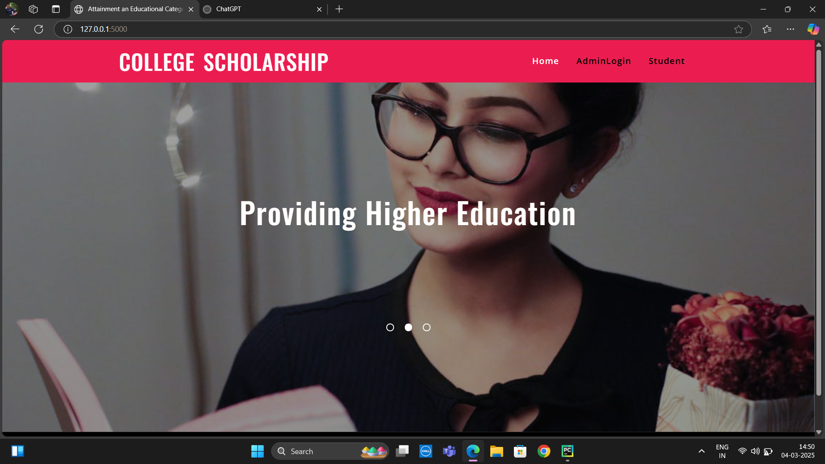
INPUT DESIGN

Slide 13
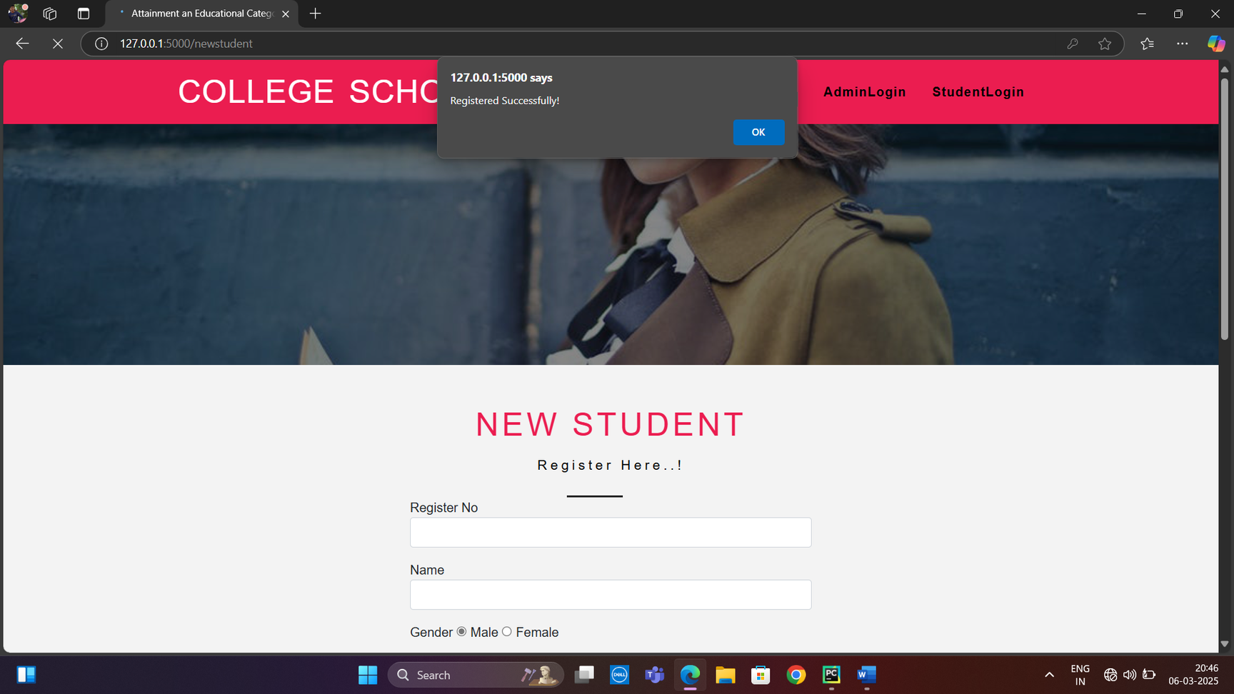

Slide 14
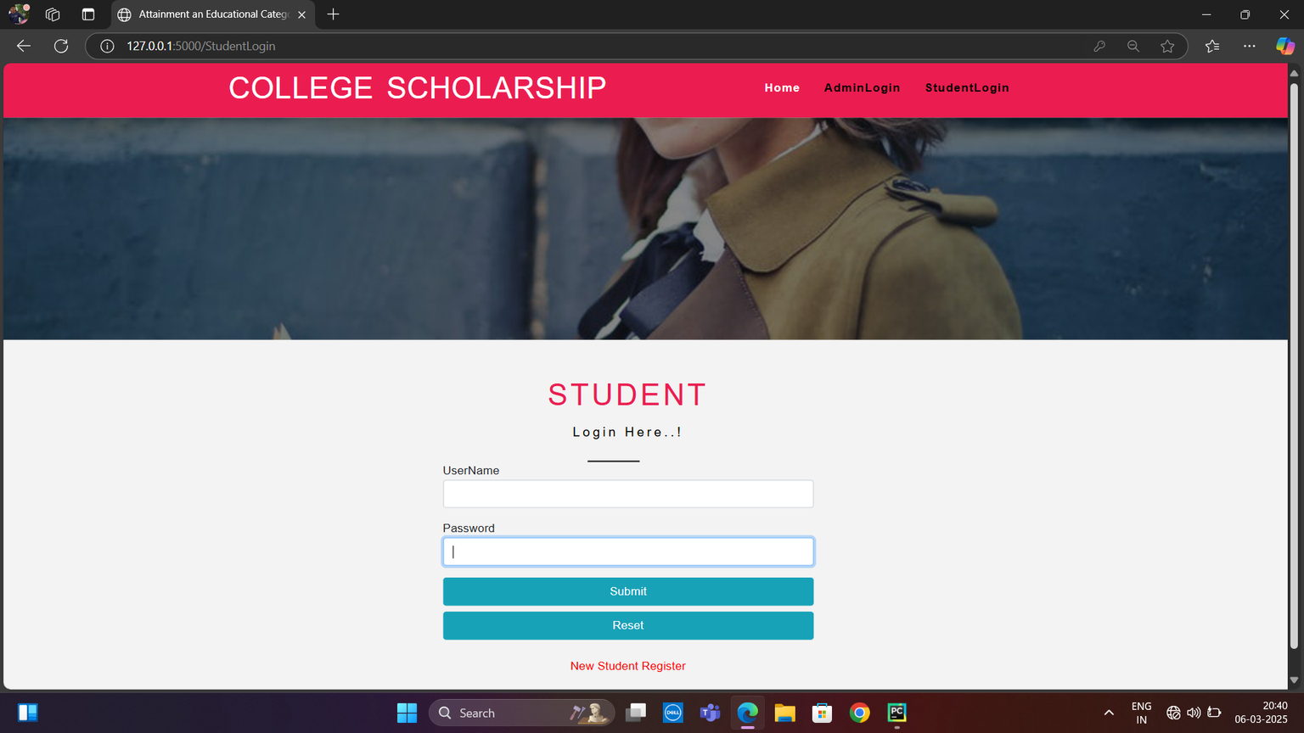

Slide 15
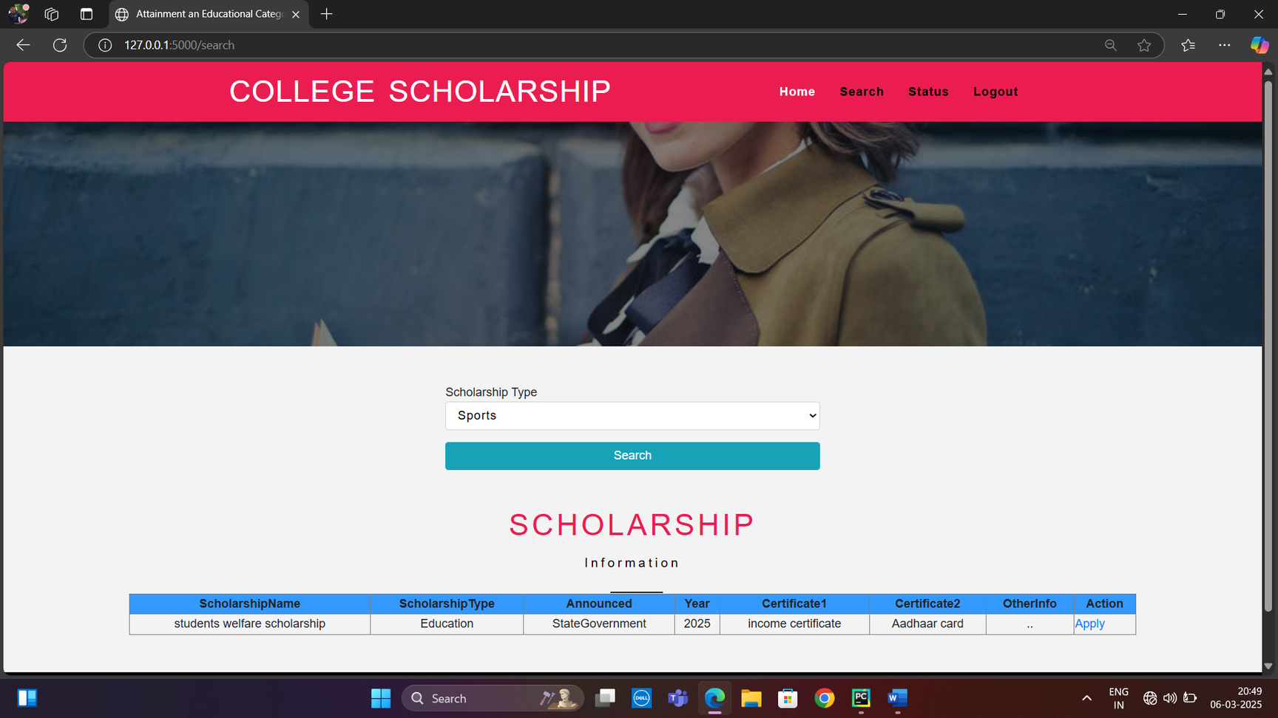

Slide 16
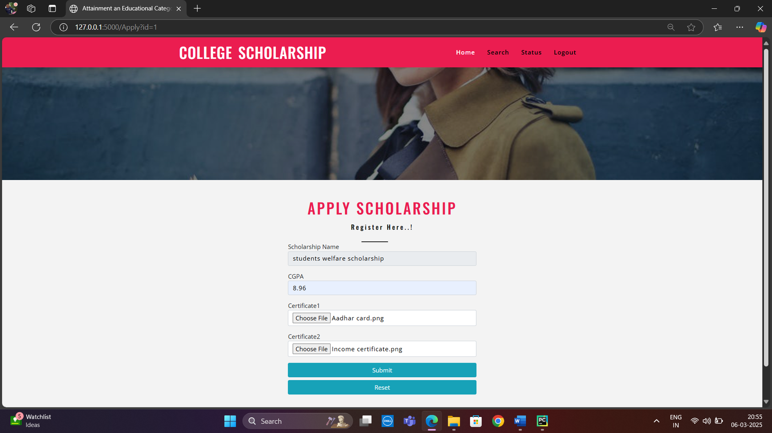

Slide 17
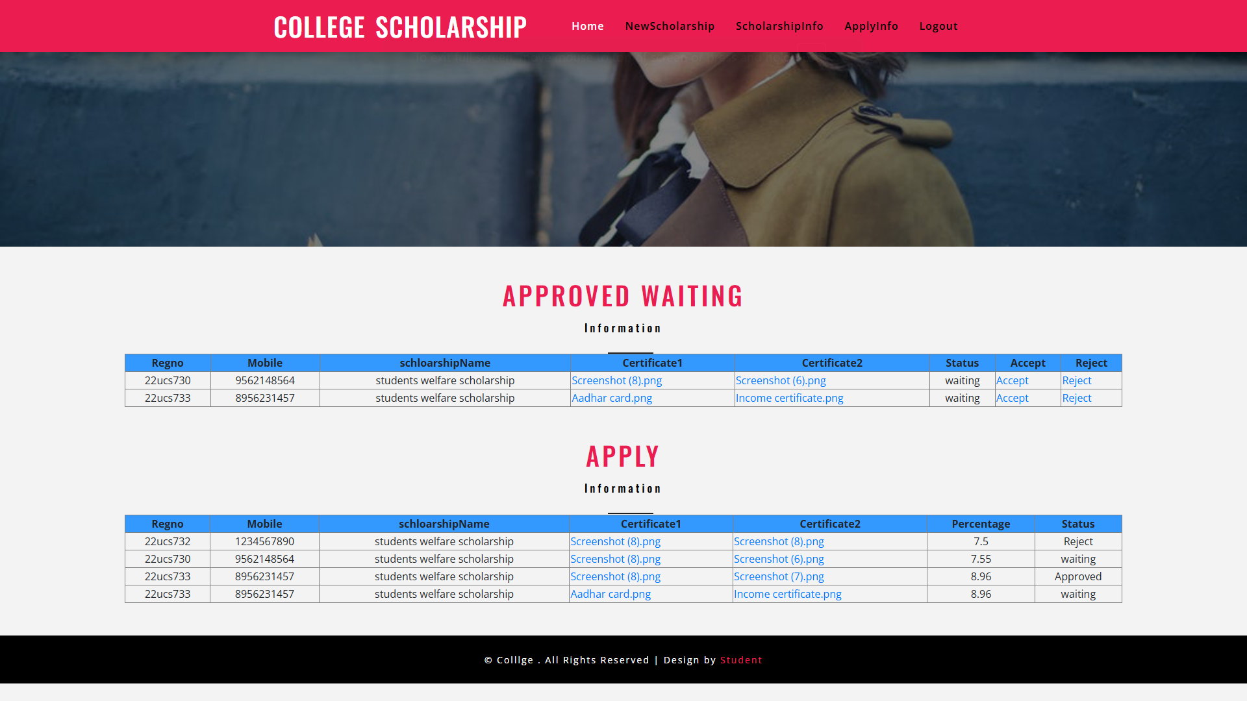

Slide 18
1.Student Reports
Student List Report: Displays all registered students with details (ID, Name, Email, Contact, Scholarship Status).
Application Status Report: Lists students along with their application status (Pending, Approved, Rejected).
Scholarship Award Report: Shows students who have been awarded scholarships, including the amount.
2. Scholarship Reports
Available Scholarships Report: Lists all available scholarships with eligibility criteria.
Scholarship Allocation Report: Shows scholarships that have been allocated and the remaining funds.
Scholarship Expiry Report: Displays scholarships that are nearing their deadline.

Slide 19
3. Financial Reports
Total Scholarships Disbursed: Displays the total amount of scholarships awarded in a specific period.
Scholarship Fund Balance Report: Shows available funds after disbursing scholarships.
Category-wise Scholarship Distribution: Highlights scholarships awarded based on categories like merit, need-based, sports, etc.
4. Admin Reports
Application Trends Report: Graph showing the number of applications received over time.
Approval and Rejection Report: Lists the number of approved and rejected applications.
Reviewer Performance Report: Displays how many applications each reviewer has processed…

Slide 20
Conclusion
In this work, an online mobile-based system e-scholarship was implemented that replaces the paper-based method. The online mobile -based application allowed students to apply for scholarship online irrespective of their geographical locations and also provide them with feedback services. The software was develop using object-oriented analysis and design. It is hoped that effective implementation of this software product would eliminate many problems discovered during system’s investigation.
We therefore make the following recommendations. Online should endeavor to adopt the e-Scholarship System software develop in this research work in order to automate their various scholarship application processes. So that the workload associated with the manual system can be reduced considerably.

Slide 21
Future enhancement
The scope of the project is the system on which the software is installed, i.e. the project is developed as a Web based application, and it will work for a particular institute.
But later on the project can be modified to operate it E-Scholarship.
In future that can create a Mobile application for this project.

Slide 22
THANK YOU

